Slide 1
Unit 3 Physical Based Models

Slide 2
Performance Models
..\unit 3.docx

Slide 3
1.1 What is anomaly detection
Anomaly detection (also outlier detection)is the identification of items, events or observations which is significantly different from the remaining data.
Anomalies are also referred to as outliers, deviants or abnormalities in the data mining and statistics literature.
In most situations, the data is created by one or more generating processes, which are able to not only represent activity in the system but also observations collected of entities.
When the generating process behaves unusually, it create anomalies or outliers.
Thus, an anomaly often contains valuable information about abnormal characteristics of the systems and elements that impact the at a generation process

Slide 4
Figure 1: the Data set with Anomaly.

Slide 5
"The data model is everything." IN fact, all anomaly detection create a model of the normal patterns in the data and assume the "normal" behavior of the data, and then calculate an outlier score of a given data point through the deviations from these patterns.

Slide 6
Anomaly detection
In data mining, anomaly detection (also outlier detection^{[1]}) is the identification of rare items, events or observations which raise suspicions by differing significantly from the majority of the data.^{[1]}
Typically the anomalous items will translate to some kind of problem such as bank fraud, a structural defect, medical problems or errors in a text.
Anomalies are also referred to as outliers, novelties, noise, deviations and exceptions.^{[2]}
In particular, in the context of abuse and network intrusion detection, the interesting objects are often not rare objects, but unexpected bursts in activity.
This pattern does not adhere to the common statistical definition of an outlier as a rare object, and many outlier detection methods (in particular unsupervised methods) will fail on such data, unless it has been aggregated appropriately.
Instead, a cluster analysis algorithm may be able to detect the micro clusters formed by these patterns.^{[3]}

Slide 7
Three broad categories of anomaly detection techniques exist.
Unsupervised anomaly detection techniques detect anomalies in an unlabeled test data set under the assumption that the majority of the instances in the data set are normal by looking for instances that seem to fit least to the remainder of the data set.
Supervised anomaly detection techniques require a data set that has been labeled as "normal" and "abnormal" and involves training a classifier (the key difference to many other statistical classification problems is the inherent unbalanced nature of outlier detection).
Semi-supervised anomaly detection techniques construct a model representing normal behavior from a given normal training data set, and then test the likelihood of a test instance to be generated by the learnt model

Slide 8
Different aspects of an anomaly detection problem
2.1 Nature of Input Data
The input data can be seen as a set of attributes. The attributes can be of different kinds such as categorical binary or continuous.
Each data might has just one attribute or multiple attributes.
The nature of attributes determine the applicability of anomaly detection.
For example, most statistical models have to be user for continuous and categorical data; for nearness neighbor based models, the nature of attributes would determine how to measure the distance.

Slide 9
Output of Anomaly Detection
Among all these applications, the data has a "normal" model ,
The output of anomalies can be spliced into two types:
Anomaly Scores: many anomaly detection algorithms output a score qualifying the level of "outlierness" of each datapoint.
Binary labels: binary label indicates whether a data point is an anomaly or not.
Despite the fact that some anomaly detection algorithms return binary labels directly, outlier scores can be converted into binary labels.
A binary label contains less information than a scoring system. However, it is the final result that is usually needed for decision making.

Slide 10
Applications
Intrusion Detection Systems: In many computer systems, different types of data are collected about the operating system files, incoming network traffic or other actions.
This data may display malicious activity or policy violations.
The recognition of such activity is referred to as intrusion detection.
Fraud Detection: fraud detection is a wide-ranging term for theft and fraud committed suing or involving a payment card as a fraudulent source of funds in a transaction.
In many cases, unauthorized use of credit card could display different patterns.
Such patterns can be used to detect outliers in credit-card transaction data.

Slide 11
Interesting Sensor Events: Sensors are normally used to monitor different environmental and location parameters in many real-world applications. Event detection is one of the primary motivating applications in the field of sensor networks.
Sudden changes, regarded as anomaly, in the the underlying patterns could show important events.
Medical Monitoring: Many medical applications collect data from various devices. Unusual data in the collection may display disease conditions.
Eco-system Disturbances Detecting: Many spatiotemporal data about weather changes, climate patterns, or land-cover patterns is collected to support valuable vision about human environmental trends or human activities that may be of interest.

Slide 12
Classification Based Anomaly Detection Techniques
Classification is used to classify a test instance on the basis of the model from a set of labeled data instances whose category membership .
1. The training phase learns a model through the labeled training data set.
2. The testing phase classifies a test data instance as normal or anomaly through the model learnt in the phase 1

Slide 13
Class based anomaly detection techniques can be divided into two categories : multi-class and one-class anomaly detection techniques on the basis of labels available.
Multi-class classification based anomaly detection techniques assume that the train data set contains labeled instances belonging to multiple normal classes. A data point is regarded as anomaly if it cannot be classifies as normal for any classes. Some multi-class classification design an anomaly score to a test instance. If none of the class are confident in classifying the test instance as normal, the instance is seen as an anomaly.

Slide 14
Figure 2: Multi-class Classification Anomaly Detection

Slide 15
One-class classification(OCC) based anomaly detection techniques assume that all training data have only one class label.
Such techniques learn a discriminative boundary around the normal instances using a one-class classification algorithm
e.g Feature Boundaries Detector for One-Class Classification FBDOCC method[Jun],One-class SVM, Least Squares One-class SVM, Kernel PCA, Gaussian Process Prior OCC, Condensed Nearest Neighbor Data Description and One-class Random Forests.
Any test instance that does not fall withes the learnt boundary is regarded as anomaly like Figure 3.

Slide 16
Figure 3. One-class Classification Anomaly Detection

Slide 17
Popular techniques
Density-based techniques (k-nearest neighbor,] local outlier factor, isolation forests,Subspace-, correlation-based and tensor-based outlier detection for high-dimensional data.
One-class support vector machines.
Replicator neural networks.^{[20]}, auto encoders, long short-term memory neural networks
Bayesian Networks.
Hidden Markov models (HMMs).
Cluster analysis-based outlier detection.
Deviations from association rules and frequent item sets.
Fuzzy logic-based outlier detection.
Ensemble techniques, using feature bagging, score normalization and different sources of diversity.
The performance of different methods depends a lot on the data set and parameters, and methods have little systematic advantages over another when compared across many data sets and parameters.

Slide 18
Application to data security
Anomaly detection was proposed for intrusion detection systems (IDS) by Dorothy Denning in 1986.
Anomaly detection for IDS is normally accomplished with thresholds and statistics, but can also be done with soft computing, and inductive learning.
Types of statistics proposed by 1999 included profiles of users, workstations, networks, remote hosts, groups of users, and programs based on frequencies, means, variances, covariances, and standard deviations.
The counterpart of anomaly detection in intrusion detection is misuse detection.

Slide 19
Software:
ELKI is an open-source Java data mining toolkit that contains several anomaly detection algorithms, as well as index acceleration for them.

Slide 20
Lifiting Models

Slide 21
MICROSTRUCTURE MODELS:
Monte Carlo Methods
Monte Carlo simulations rely on rules (such as energy reduction) and random probability events to mimic atomic motion.
This is equivalent to literally rolling the dice to decide what happens.
It is a favorite technique for modeling microstructure evolution during sintering and is well positioned to track grain and pore behavior.
To start with, a microstructure is constructed consisting of a large number of discrete points in space.
These are termed pixels in two-dimensional simulations and voxels in three-dimensional simulations.
Each point is assigned a flavor, color, chemistry, or orientation–some means to create granularity in the initial microstructure. The starting point might be input by the operator.
A few models nucleate the structure using random coordinates, and then grow around those nuclei–the first nucleus is “1” and the second is “2” and so on.
After nucleating, then particles, grains, or pores are expanded around each nucleus, usually with uniform radial growth, until all the space is filled. This gives the starting randomized microstructure.

Slide 22
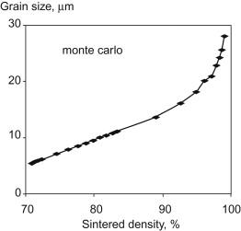
Random events and energy reduction rules then determine the evolution of the structure and its final stability.
A random number is generated, from which a candidate point is selected and tested versus a random possible move.
Evolution of the structure depends on simple rules; in a two-dimensional simulation a point joins a neighboring group if the energy goes down.
If the points are alike, they tend to agglomerate or bond together, and that leads to a decline in interface energy.
Monte Carlo methods are a favorite for microstructural coarsening studies, such as grain growth during liquid phase sintering , particle coalescence by surface diffusion, percolation and conductivity, and pore-boundary interactions.

Slide 23
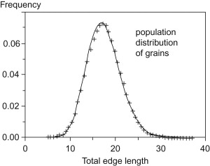
Another gain from Monte Carlo simulations is the isolation of generalized rules on the microstructure evolution during sintering.
Example of the grain edge length distribution determined for a microstructure by a Monte Carlo simulation .
This provides insight that is not easily gained in traditional laboratory experiments. Although not yet pinned to actual materials, progress in this field is promising and some of the simulations are developing into commercial packages.

Slide 24
Microstructural Models.
The microstructure of cement-based materials is controlled by their constituents, the mixture proportions, processing (e.g., mixing, consolidation, and curing), and degree of hydration.
The properties of the hardened cement-based materials are dependent on their microstructure; the capillary pore structure, which includes the transition zone between the cement paste and aggregates, usually governs the transport properties of concrete, while larger voids reduce the strength of concrete.
Therefore, microstructure characterization and modeling have come to make a major contribution to understanding the performance of cement-based materials.
The progress of microstructure modeling has been comprehensively reviewed in two parts by Jennings,
Part 1 deals with historical developments and provides a general overview
Part 2 addresses recent developments.
In Part 1, models of the microstructure of cement-based materials and of shrinkage and creep are described, while Part 2 describes models linking microstructure with flow properties, moisture capacity, and shrinkage and creep.
Garboczi and Bentz reported on the state-of-the-art of fundamental computer simulation models for cement-based materials and with Martys, reviewed relationships between transport properties and the microstructure of cement-based materials.
Van Breugel used simulation models to link microstructural development with hydration kinetics of cement-based materials.
https://www.sciencedirect.com/topics/materials-science/microstructure-modeling

Slide 25
Dynamic Estimation Tuning
Dynamic estimation tuning is the process of adjusting certain objective function terms to give more desirable solutions.
As an example, a dynamic estimation application such as moving horizon estimation (MHE) may either track noisy data too closely or the updates may be too slow to catch unmeasured disturbances of interest.
Tuning is the process of achieving acceptable estimator performance based on unique aspects of the application.

Slide 26
Common Tuning Parameters for MHE
Tuning typically involves adjustment of objective function terms or constraints that limit the rate of change (DMAX), penalize the rate of change (DCOST), or set absolute bounds (LOWER and UPPER).
Measurement availability is indicated by the parameter (FSTATUS).
The optimizer can also include (1=on) or exclude (0=off) a certain adjustable parameter (Fixed Value) or manipulated variable (Manipulated Value ) with STATUS.
Another important tuning consideration is the time horizon length.
Including more points in the time horizon allows the estimator to reconcile the model to more data but also increases computational time.

Slide 27
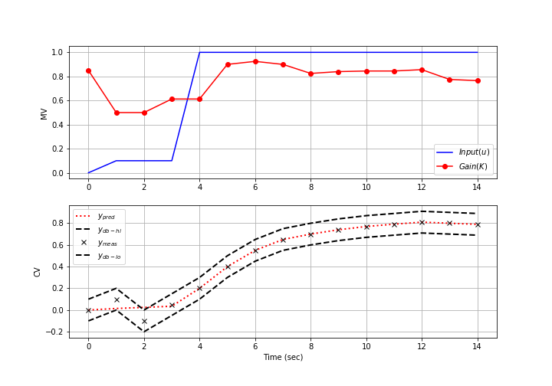
http://apmonitor.com/do/uploads/Main/mhe_tuning.mp4

Slide 28
Below are common application, FV, MV, and CV tuning constants that are adjusted to achieve desired model predictive control performance.
Application tuning
DIAGLEVEL = diagnostic level (0-10) for solution information
EV_TYPE = 1 for l₁-norm and 2 for squared error objective
IMODE = 5 or 8 for moving horizon estimation
MAX_ITER = maximum iterations
MAX_TIME = maximum time before stopping
MV_TYPE = Set default MV type with 0=zero-order hold, 1=linear interpolation
SOLVER
0=Try all available solvers
1=APOPT (MINLP, Active Set SQP)
2=BPOPT (NLP, Interior Point, SQP)
3=IPOPT (NLP, Interior Point, SQP)
Fixed Value (FV) - single parameter value over time horizon
DMAX = maximum that FV can move each cycle
LOWER = lower FV bound
FSTATUS = feedback status with 1=measured, 0=off
STATUS = turn on (1) or off (0) FV
UPPER = upper FV bound

Slide 29
Manipulated Variable (MV) - parameter can change over time horizon
COST = (+) minimize MV, (-) maximize MV
DCOST = penalty for MV movement
DMAX = maximum that MV can move each cycle
FSTATUS = feedback status with 1=measured, 0=off
LOWER = lower MV bound
MV_TYPE = MV type with 0=zero-order hold, 1=linear interpolation
STATUS = turn on (1) or off (0) MV
UPPER = upper MV bound
Controlled Variable (CV) tuning
COST = (+) minimize MV, (-) maximize MV
FSTATUS = feedback status with 1=measured, 0=off
MEAS_GAP = measurement gap for estimator dead-band
There are several ways to change the tuning values.
Tuning values can either be specified before an application is initialized or while an application is running.
To change a tuning value before the application is loaded, use the apm_option() function such as the following example to change the lower bound in MATLAB or Python for the FV named p.
apm_option(server,app,'p.LOWER',0)

Slide 30
The upper and lower measurement deadband for a CV named y are set to values around the measurement.
In this case, an acceptable range for the model prediction is to intersect the measurement of 10.0 between 9.5 and 10.5 with a MEAS_GAP of 1.0 (or +/-0.5).
Application constants are modified by indicating that the constant belongs to the group apm.
IMODE is adjusted to either solve the MHE problem with a simultaneous (5) or sequential method (8).
In the case below, the application IMODE is changed to simultaneous mode.
apm_option(server,app,'y.MEAS_GAP',1.0)
apm_option(server,app,'apm.IMODE',5)

Slide 31
Exercise
Objective: Design an estimator to predict an unknown parameters so that a simple model is able to predict the response of a more complex process. Tune the estimator to achieve either tracking or predictive performance. Estimated time: 1 hour.
Design an estimator to predict K and tau of a 1st order model to predict the dynamic response of a 1st order, 2nd order, and 10th order process.
For the 2nd and 10th order systems, there is process/model mismatch.
This means that the structure of the model can never exactly match the actual process because the equations are inherently incorrect.
The parameter values are adjusted to best approximate the process even though the model is deficient.
The process order is adjusted in the file process.apm file in the Constants section.

Slide 32
Constants ! process model order n = 1 ! change to 1, 2, and 10
In each case, tune the estimator to favor either acceptable tracking or predictive performance.
Tracking performance is the ability of the estimator to synchronize with measurements and is demonstrated with overall agreement between the model predictions and the measurements.
Predictive performance sacrifices tracking performance to achieve more consistent values that are valid over a longer predictive horizon for model predictive control.
https://www.youtube.com/watch?v=qtoM1KBTzIU&feature=emb_rel_pause
http://apmonitor.com/do/index.php/Main/AdvancedTemperatureControl

